Slide 1
Math 769: Statistical Learning

Slide 2
K-Means Clustering
Shahrzad Jamshidi, PhD

Slide 3
Last Time
We discussed how SVM constructs a decision boundary by finding one that corresponds to a maximal margin between two classes.
If the classes overlap, the technique allows for slack to be incorporated.

Slide 4
Objectives
Discuss the aim of k-means clustering.
Discuss the strengths and limitations of k-means clustering.
Define the k-means clustering algorithm.

Slide 5
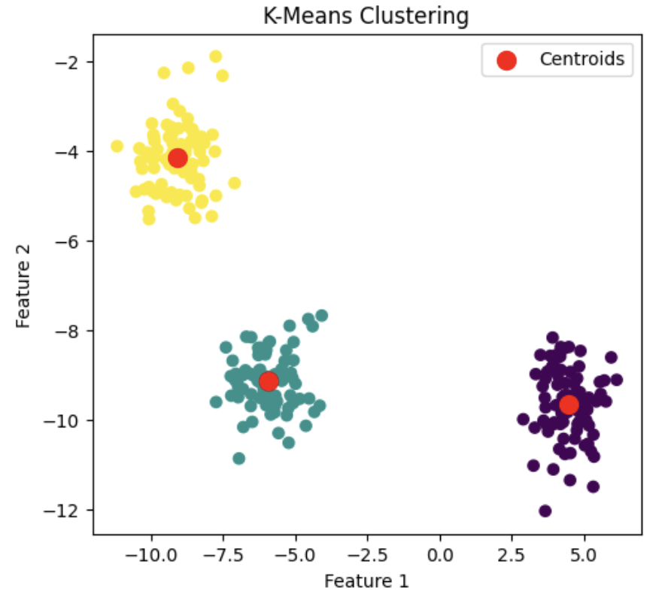
What is k-Means Clustering?
K-means clustering is a widely-used, unsupervised learning method for grouping data into k distinct, non-overlapping clusters.
It does this by minimizing the variance within each cluster.
The 'means' in the algorithm's name refers to the centroid of each cluster (depicted in red).

Slide 6
About Algorithm
The algorithm works iteratively to assign each data point to one of k groups based on the features that are provided.
Data points are clustered based on feature similarity determined by a chosen metric for distance.

Slide 7
Conceptual Steps of Algorithm
Steps
Select k random initial centroids (red Xs).
Assign each data point to the nearest centroid.
Recalculate the centroid of each cluster.
Repeat 2 & 3 until convergence.

Slide 8
Strengths and Weaknesses
Strengths
Simple and easy to implement.
Efficient in terms of computational cost.
Works well with large datasets.
Weaknesses
Sensitive to the initial choice of centroids.
Struggles with non-spherical shapes or varying sizes of clusters.
Not suitable for datasets with complex, overlapping distributions.

Slide 9
Initialization Matters
Good Initialization
Bad Initialization

Slide 10
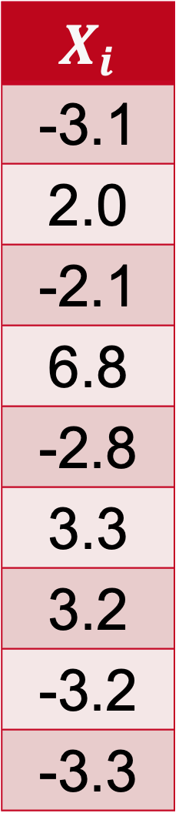
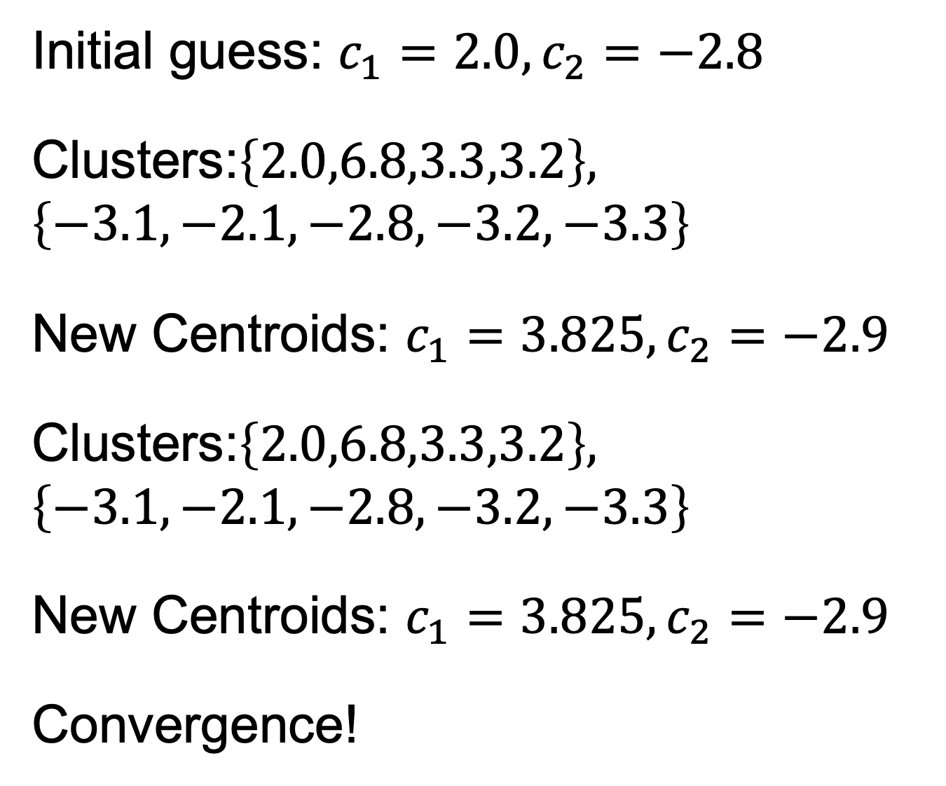
Example: 2-Means Clustering
Initial guess: $c_{1}=2.0, c_{2}=−2.8$
Clusters:$\left\{2.0,6.8,3.3,3.2\right\}, \left\{−3.1,−2.1,−2.8,−3.2, −3.3\right\}$
New Centroids: $c_{1}=3.825, c_{2}=−2.9$
Clusters:$\left\{2.0,6.8,3.3,3.2\right\}, \left\{−3.1,−2.1,−2.8,−3.2, −3.3\right\}$
New Centroids: $c_{1}=3.825, c_{2}=−2.9$
Convergence!
$$X_{i}$$
-3.1
2.0
-2.1
6.8
-2.8
3.3
3.2
-3.2
-3.3

Slide 11
Algorithm in Practice
Clusters are constructed around centroids based on their Euclidean distance.
The closest centroid determines the cluster.
Centroids are then redefined by taking the mean of the points (in higher dimension, we compute the mean of each dimension).

Slide 12
Conclusion
k-means clustering is an unsupervised model designed to cluster data into groups.
The method involves specifying the number of clusters, making an initial guess of the centroids, and sorting points based on the nearest centroid.
Once sorted, new centroids are formed and the points are grouped once again.
The process repeats until the centroids converge.

